Slide 1

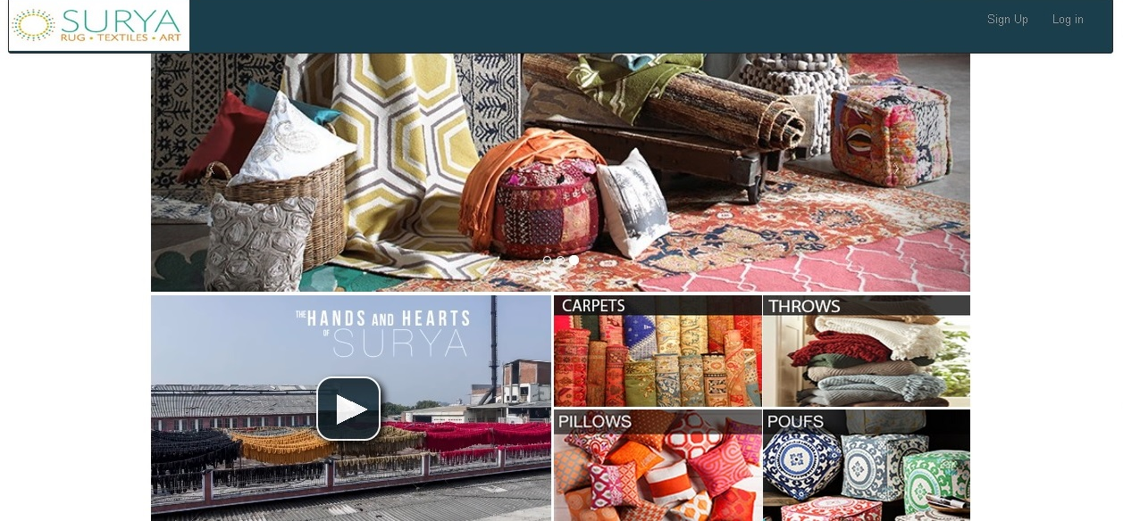
SURYA CARPET RUG-TEXTILES-ART This Manual is for using the Surya Carpet website. This is the Home Screen of the Website.

Slide 2
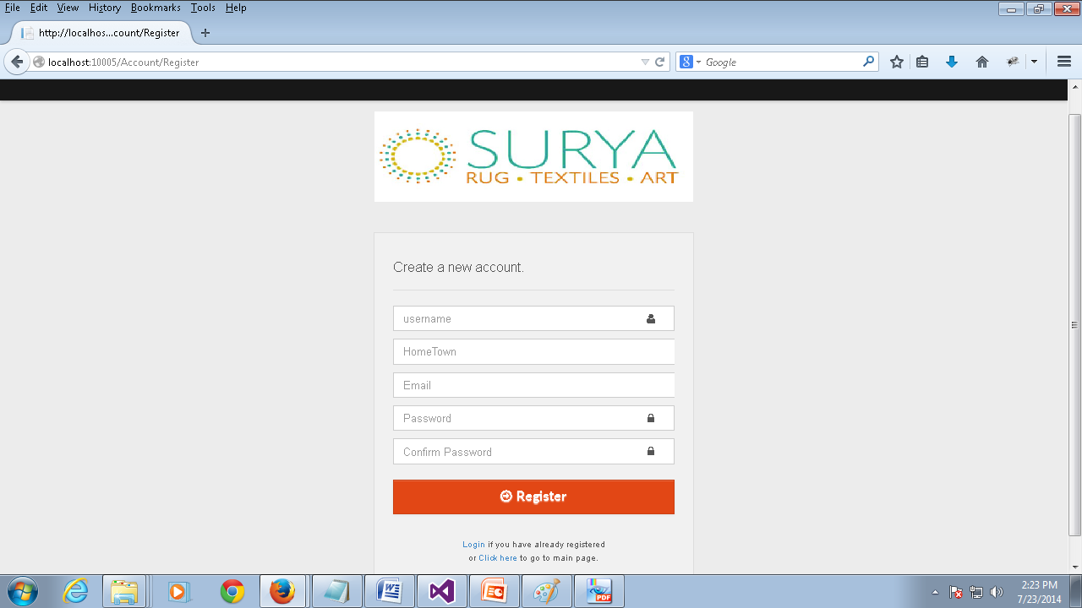
Sign Up Page
To Access the Surya Carpet Website you must first register your account. To register your account you must fill in all your details in the Registration form as show in the picture and click Register.
Field Name | Narration | Field Name | Narration
User Name | User name with which you would like to access the website. Example formats :yourname201, yourname. | Password | The password for your account
Home Town | The name of the home town of the user. | Confirm Password | You should retype your password here.
Email | Your email address. Please make sure to provide a valid email address as the email you provide will be the mode of communication between you and the company. | Register | Once you have filled all the above details please click this button to register with Surya website.
***Once you have registered please wait for role assignment before you login which you will be notified through your registered email.

Slide 3
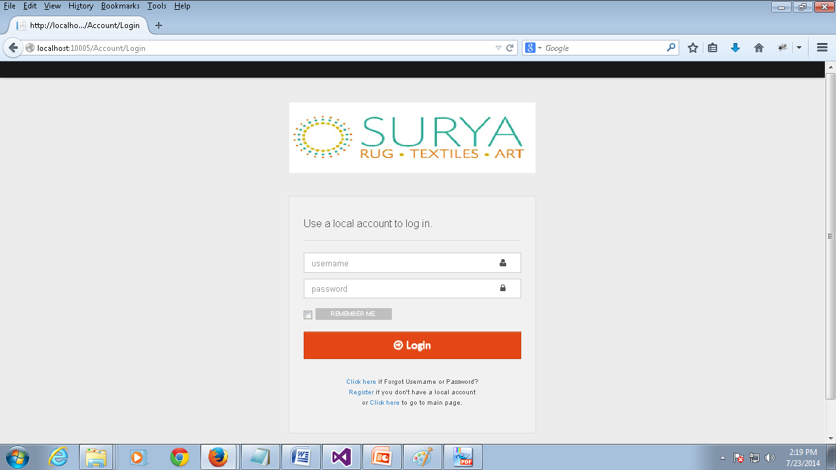
Login Page
Field Name | Narration
User Name | The user name entered by you while registering to Surya Website
Password | The password entered by you while registering to Surya Website.
***Once the role assignment is done you will be receiving a confirmation email. Please note that you will be able to use your account to access the website only after receiving the confirmation email. And the user name and password fields are case sensitive/

Slide 4
***Please note that the next two sections(slides) requesting you to fill up the details appear only during your first login. So make sure to fill the forms with valid information without skipping anything.

Slide 5
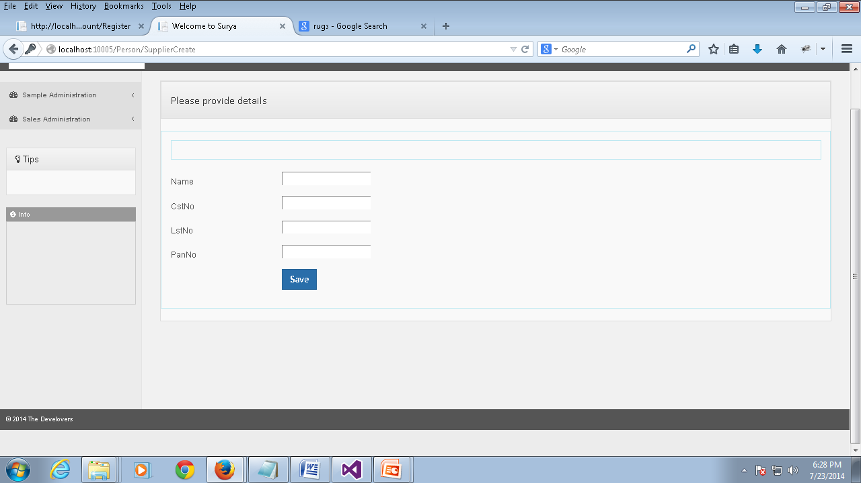
Supplier Details
Supplier Details | This page shows all the fields to fill in the supplier details. If a supplier logs in for the first time he would be redirected to this page.
Field Name | Narration | Field Name | Narration
Name | The name of the customer should be specified here | LST NO | The LST No information of the customer should be provided here
CST NO | The customer number information should be entered here. | PAN NO | The pan number(a unique number information of the supplier should be specified here.

Slide 6
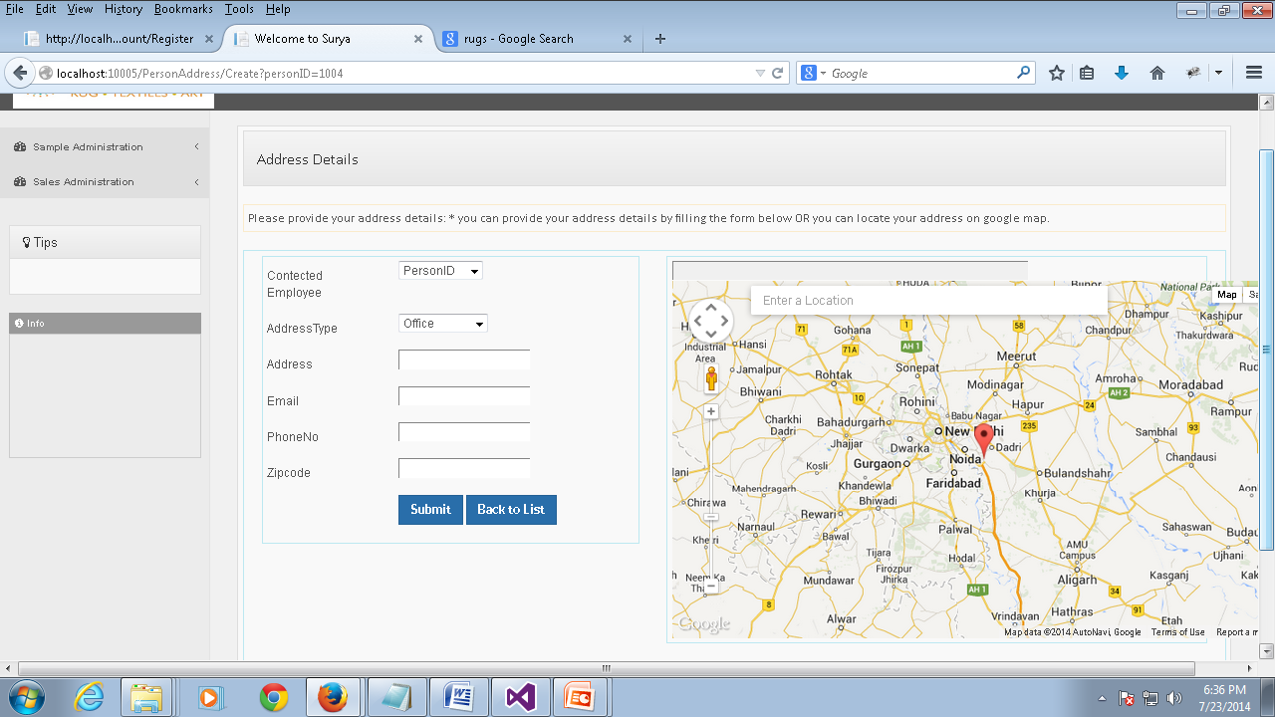
Supplier Address Information
Field Name | Narration | Field Name | Narration
Contacted Employee | Here the supplier should provide the information of the contacted employee | Phone No | The phone number information of the customer should be provided here.
Address Type | The address type of the customer (i.e. Office or Ware House or House) should be provided here | Zip Code | The zip code information of the customer should be provided here.
Address | The address information of the customer should be provided here
Email | The email address of the customer should be provided here.

Slide 7
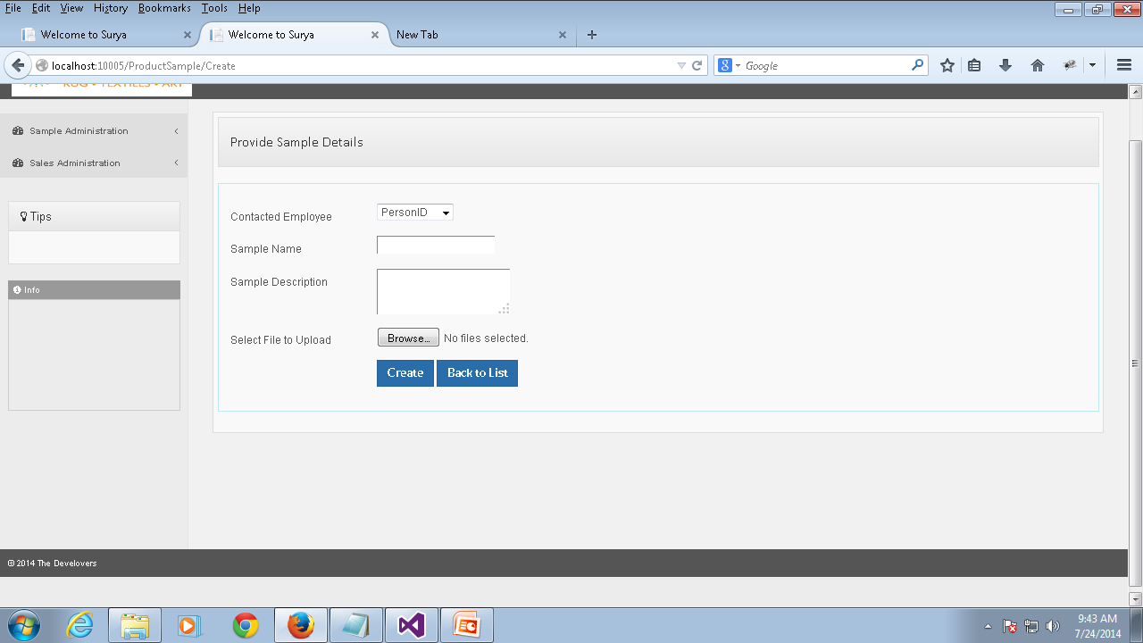
Create Product Sample
Create Sample | Here the supplier can Add a new product sample. You will be redirected to this page once you have filled the address details. Once the sample is added you should wait for a email from the manager specifying the status of your product approval.
Field Name | Narration | Field Name | Narration
Contacted Employee | You should specify the contacted employee information in this field. | Sample Description | A brief description of the product sample should be specified here
Sample Name | The product sample name should be entered here. | File to Upload | A sample image of the file should be selected using this field
Create | You can create your sample after filling all the details by clicking this link. | Back To List | This link takes you back to your product sample list.

Slide 8
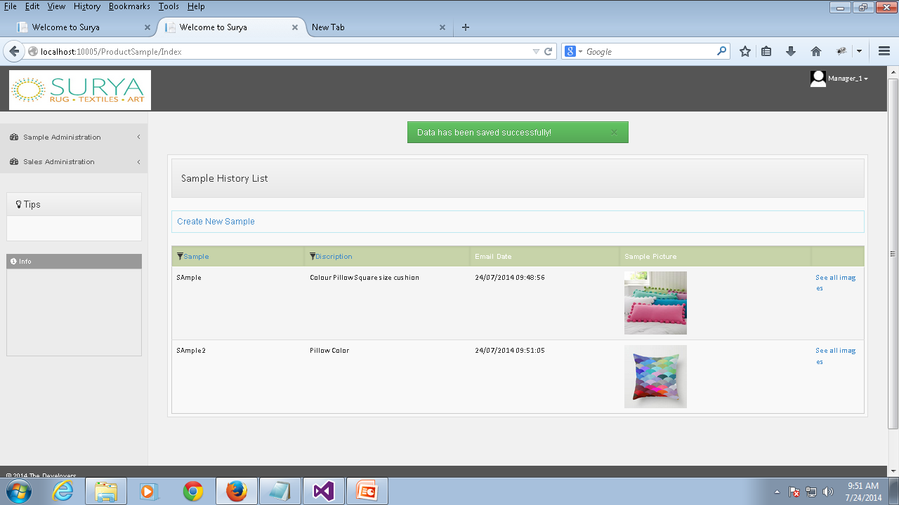
Sample History List
Sample History List | This page shows the details about all your product sample. You will be redirected to this page once you have added a new sample product. You can access this page under the sample administration category from the sample application tab.
Permission | Action | Narration | Roles
 | Create | You can create a new product sample by clicking this link. | Supplier.
 | See All Images | Clicking this link will display all the images you have uploaded for the particular product sample. | Supplier.

Slide 9
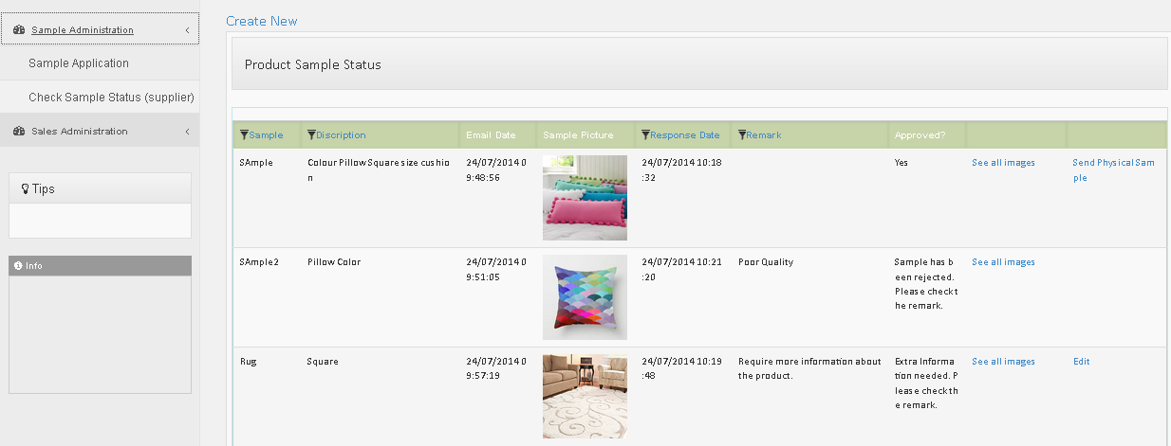
Product Sample Status
Product Sample Status | This page shows all the status information about the product sample. You can access this page under the Sample Administration category form the check sample status tab. The approved category shows the product approval status. Yes indicates the approval of the product by the manager and the you should check the reasons under the remarks category for the rejected and more information status.
Permission | Action | Narration | Roles
 | Create | You can create a new product sample using this link. | Supplier.
 | See All Images | Clicking this link will display all the images you have uploaded for the particular product sample. | Supplier.
 | Send Physical Sample | Once your product is approved and you have sent a physical sample to the corresponding office then you can click this link and submit the physical sample mailing information. | Supplier.

Slide 10
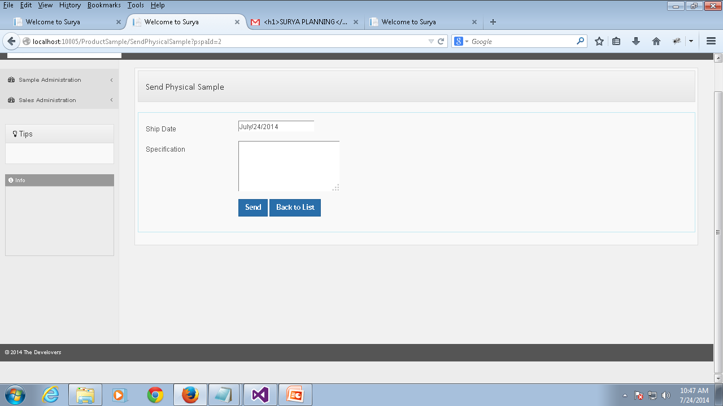
Send Physical Sample
Send Physical Sample | Once the product sample is approved by the manager you will be receiving a mail notification indicating the approval of the product. Then you can send a physical sample to the corresponding office and submit the corresponding mailing details in this section.
Ship Date | You should specify the date on which the product is shipped. | Send | Click this button once you have submitted all the details of the mailing information
Specification | All the details about the mailing information of the physical sample. | Back To List | Clicking this link will take you back to the sample status information window.

Slide 11
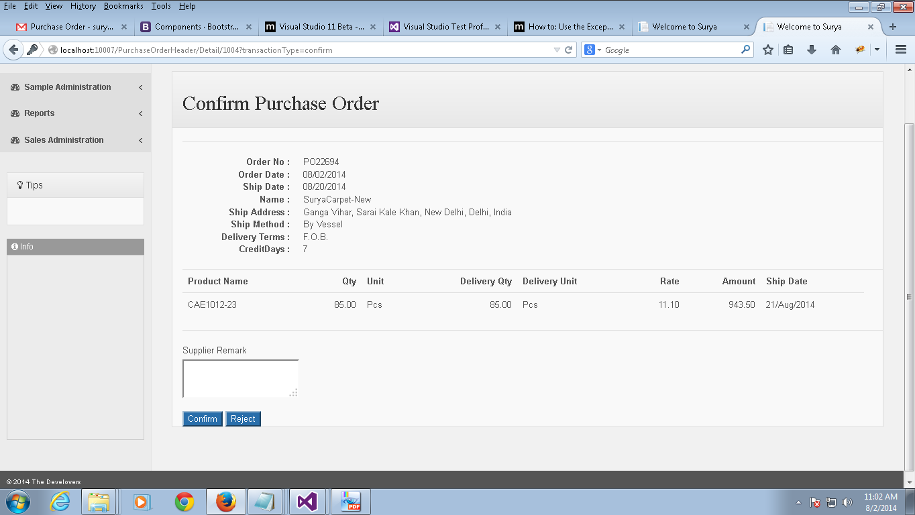
Confirm Purchase Order
Confirm Purchase Order | If any purchase order is approved by manager then an email will be sent to the corresponding supplier. The supplier can open the mail and click the link which will redirect to this page to confirm or reject the order. (Note that you will be asked to provide your login details before you redirect to this page)
Permission | Action | Narration | Roles
 | Supplier Remark | Supplier can add remarks after approving or rejecting the order | Supplier.
 | Confirm | Supplier can confirm the order by clicking this link | Supplier.
 | Reject | Supplier can reject the order by clicking this link. | Supplier.

Slide 12
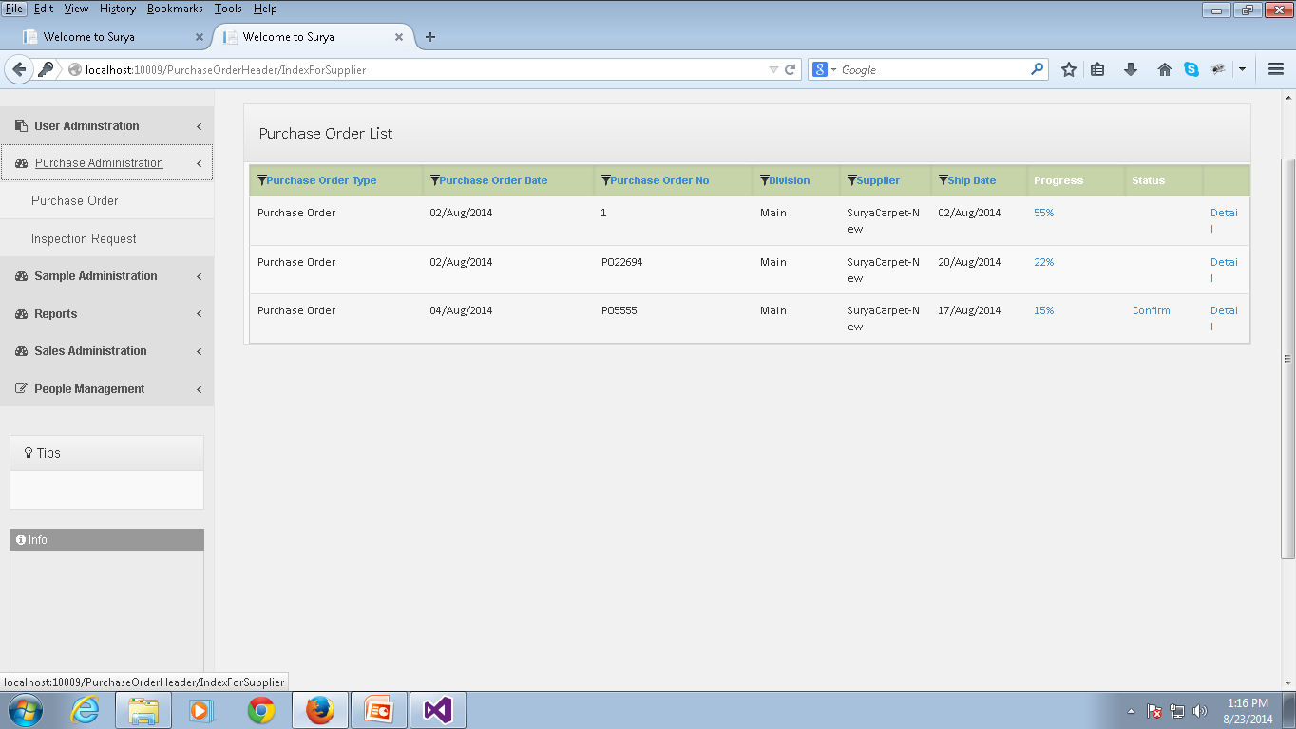
Purchase Order List
Purchase Order | This page contains purchase orders relevant to the supplier which are approved by the manager. The list contains the orders confirmed by the supplier and also the pending orders. The supplier can access the purchase order details and confirm the order by clicking the confirm link.
Permission | Action | Narration | Roles
 | Progress | This shows the current progress percentage of the particular purchase order. Supplier can update the status by clicking the progress percentage . | Supplier.
 | Confirm | Supplier can confirm the order by clicking this link | Supplier.
 | Detail | Supplier can view the details of the purchase order by clicking the corresponding details link. | Supplier.

Slide 13
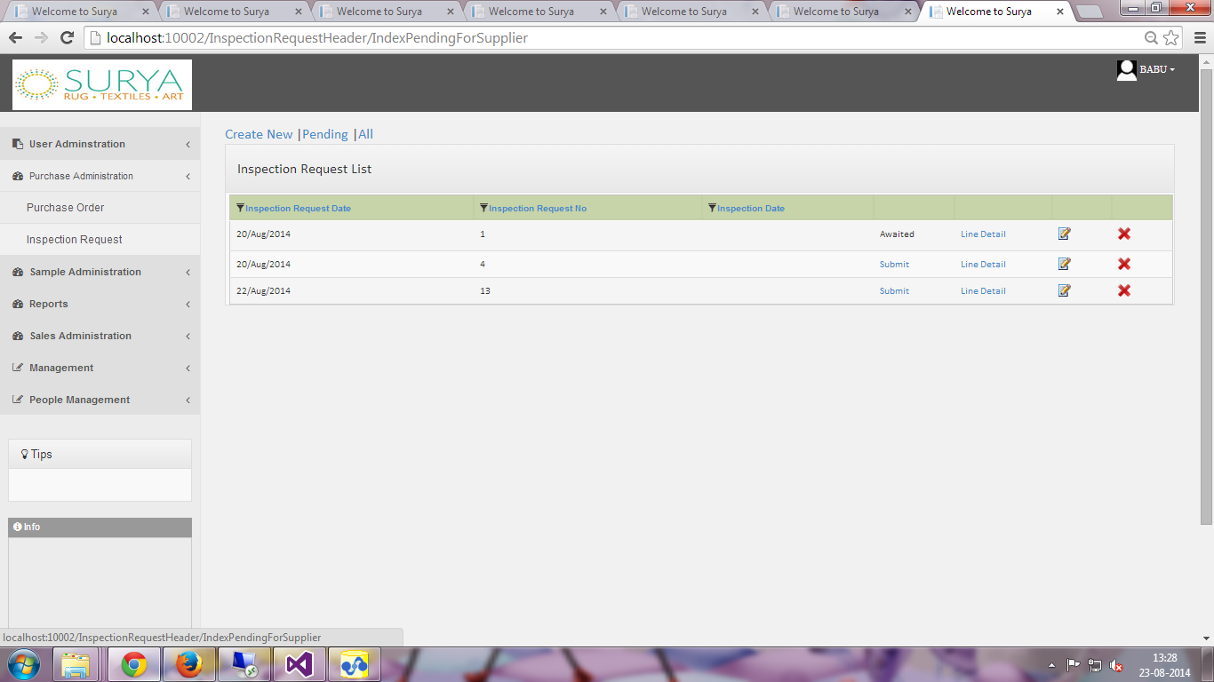
Inspection Request List
Inspection Request | This page contains the list of Inspection requests made by the supplier. You can toggle to show only the pending requests or all requests by clicking the corresponding links. You can access this page under the Purchase Administration category from the Inspection Request tab.
Permission | Action | Narration | Roles
 | Create | You can create a new request by clicking this link.(More information about this is provided in the next slide) | Supplier.
 | Awaited | This specifies that the inspection request is not yet approved by the inspection manager.
 | Approved | This specifies that the Inspection Manager has approved the inspection request and is pending for inspection.
 | Submit | If you have created inspection request line and not yet submitted you can submit it anytime using this link. | Supplier.
 | Line Detail | You can view the line information of the inspection request using this link.(You can see more information about this next to inspection request line slide). | Supplier.
 | Modify | You can modify the Inspection request details | Supplier.
 | Delete | You can delete the inspection request using this link. | Supplier.

Slide 14
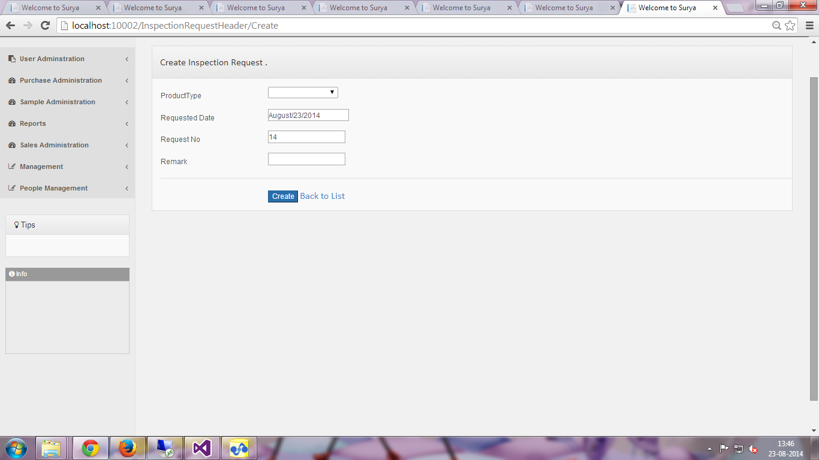
Create Inspection Request
Create Inspection Request | You can create a new Inspection Request using this page.
Field Name | Narration | Field Name | Narration
Product Type | You can select the product type for which you are creating the inspection request. | Requested Date | This specifies the date on which the inspection is created.
Request No | The Request No is a auto generated number to represent the document | Remark | You can add remarks if there are any.
Create | You can create your Inspection request after filling all the details by clicking this link. | Back To List | This link takes you back to your Inspection request index list.

Slide 15
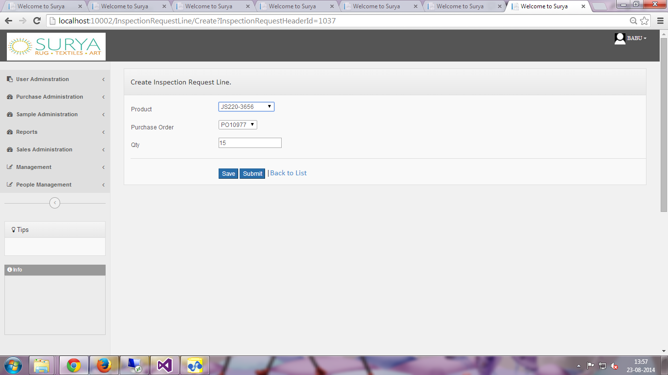
Inspection Request Line
Create Inspection Request Line | You can create a new Inspection Request line using this page. The product selection and the quantity information is provided here.
Field Name | Narration | Field Name | Narration
Product | You can select the product for which you are creating the inspection request. | Purchase Order | Here you have to specify the purchase order for which the product belongs to.
Quantity | You can enter the quantity of the products for which you are creating the inspection request. | Save | You can save the line detail for inspection request by clicking this link and you will be redirected to create a new inspection request line.
Submit | You can finally submit the Inspection request by clicking this link.

Slide 16
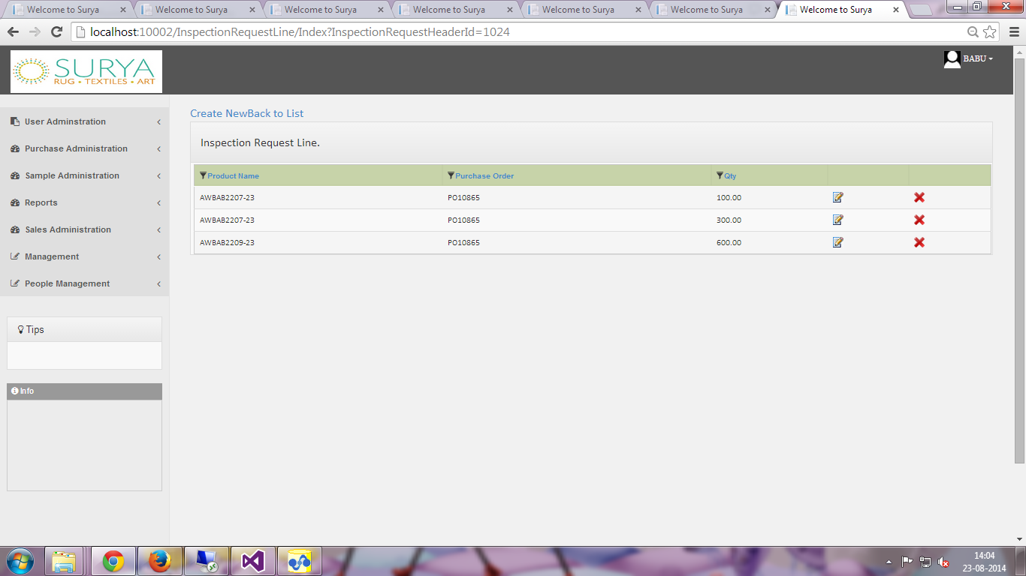
Line Detail
Line Detail | You can view the line detail information of a particular inspection request from this page.
Permission | Action | Narration | Roles
 | Create | You can add a new Inspection request line for a particular inspection request using this link. | Supplier.
 | Modify | You can make changes to the Inspection request line using this icon | Supplier.
 | Delete | You can delete the inspection request using this icon. | Supplier.

Slide 17
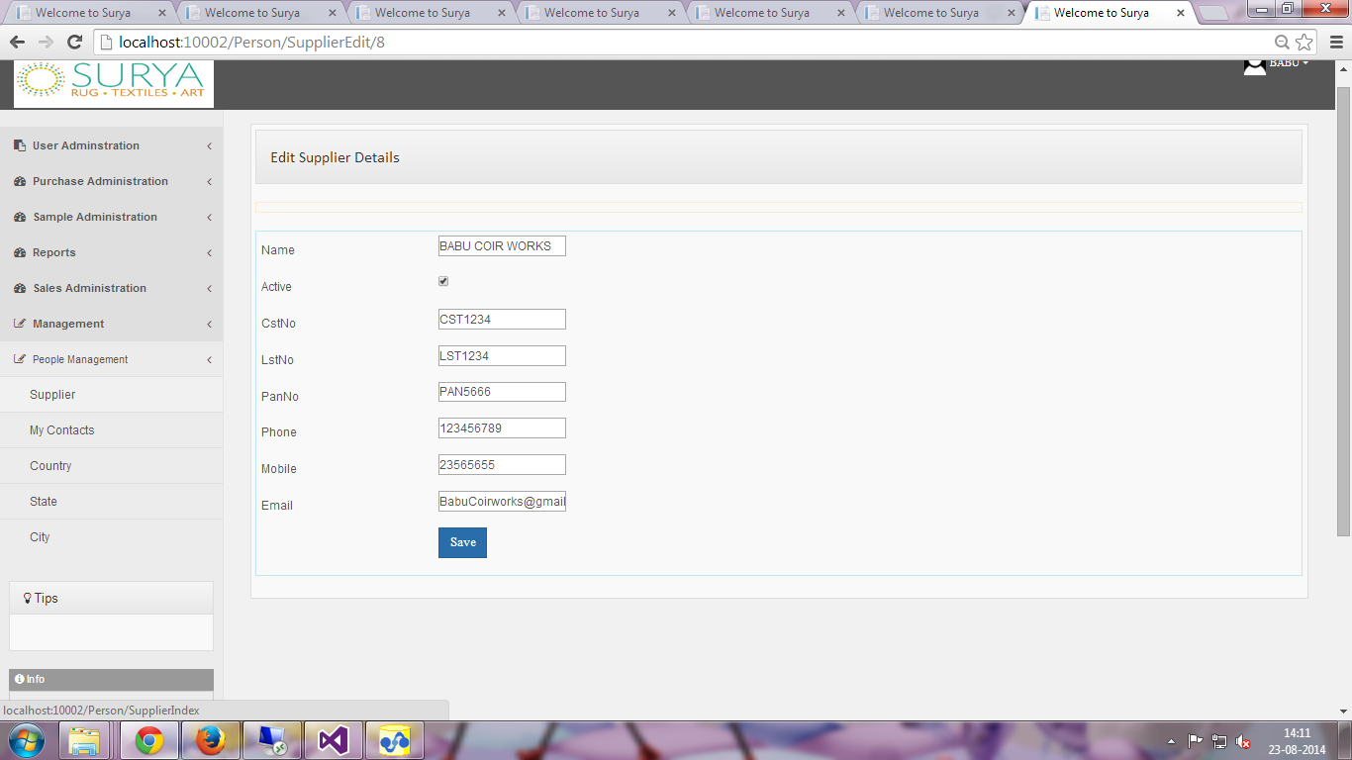

Supplier Details
Supplier Details | The supplier can view his details from this page and also make modifications to his details. After filling all the details and clicking the save button will save the details of the supplier.
Field Name | Narration | Field Name | Narration
Name | This field stores the name of the supplier | PAN No | You should enter your pan number in this fields.
Active | This represents whether the supplier is active or not. | Phone | You should enter your phone number in this field.
CST No | You should enter the CST No in this field | Mobile | You should enter your mobile number in this field.
LST No | You should enter the LST No in this field | Email | You should enter your email in this field.

Slide 18
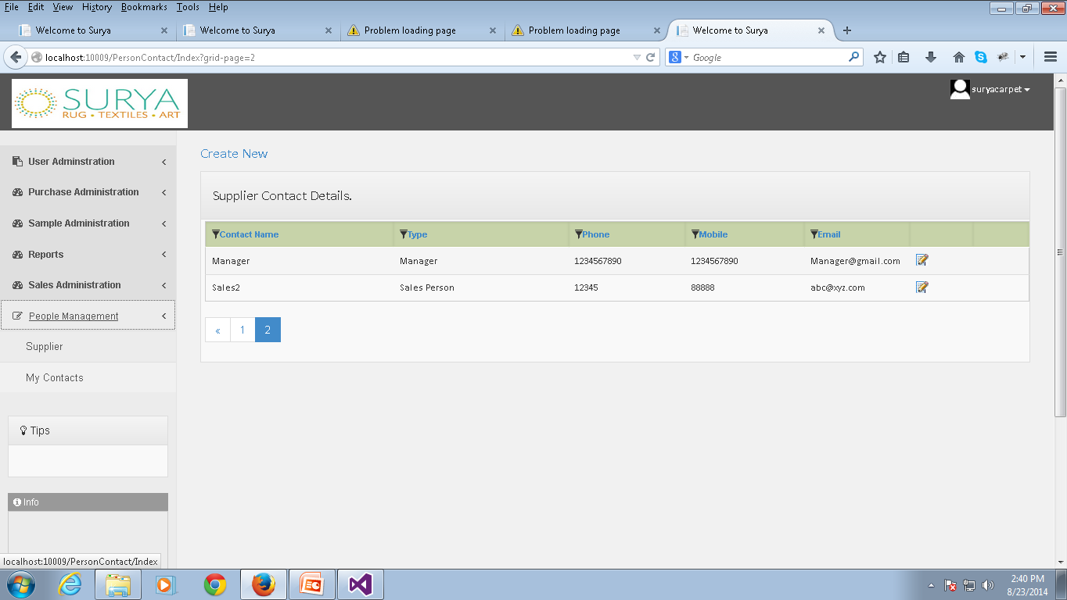
My Contact
My Contacts | The supplier can view his contact details using this link. You can access this page under the People Management category from the My Contacts tab.
Permission | Action | Narration | Roles
 | Create | You can add a new contact using this link.(You can find out more about this in the next slide) | Supplier.
 | Modify | You can make changes to the contact information using this icon. | Supplier.

Slide 19
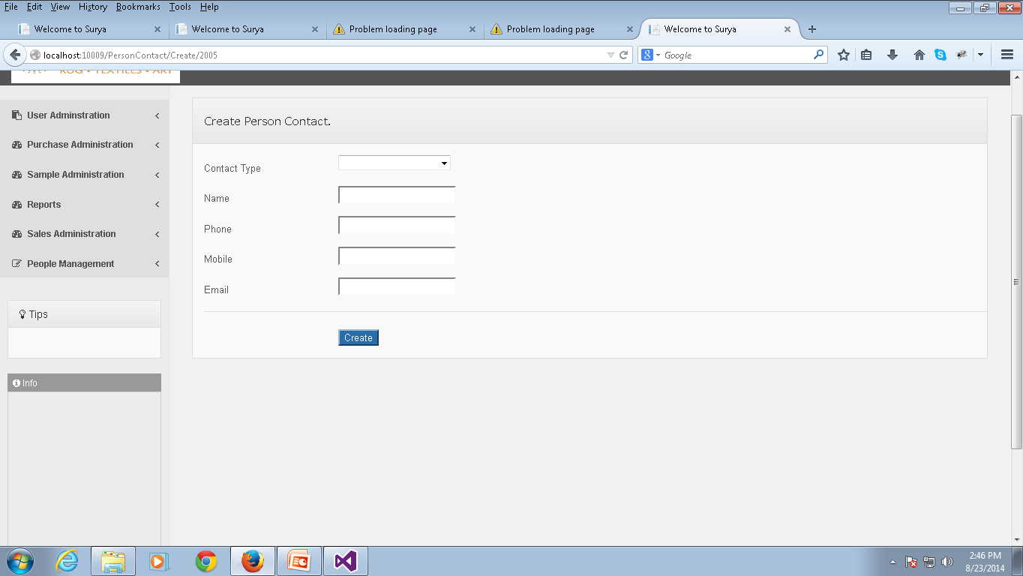
Create Person Contact
Create Person Contact | You can add a new contact person for the supplier using this page.
Field Name | Narration | Field Name | Narration
Contact Type | This specifies the type of contact you are adding. | Name | You should enter the name of the Contact person here.
Phone | You must enter the phone number of the contact person here. | Mobile | You should enter the mobile number of the contact person here.
Email | You must enter the email information of the contact person | Create | After filling all the fields you can click this link to save the new contact information

